Slide 1
SPIDERS OF K.K SCHOOL
YOGESH.J & SHOBITH.D.P
Class: 9

Slide 2
INTRODUCTION
Five acres of land
Rich bio-diversity
Organic garden

Slide 3
OBJECTIVE
Understand the different species of spiders

Slide 4
STUDY AREA

Slide 5
SPIDERS
Kingdom → Animalia
Phylum → Arthropoda
Class → Arachnidae
Spiders have eight legs and have fangs to inject venom.
Arthropoda is the largest order and rank seventh in total species diversity among all other organisms.
The lifespan of a spider vary from species to species from 3 to 20 years.

Slide 6
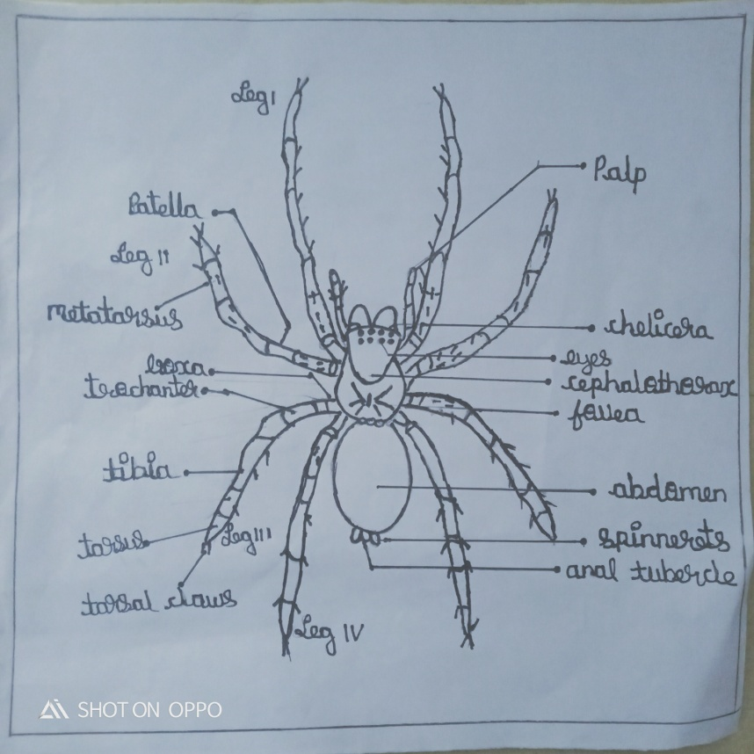
STRUCTURE OF A SPIDER

Slide 7
IMPORTANCE OF SPIDERS IN ECO-SYSTEM
The most important predators of insects.
Keep insect population under control.
Help to control the spread of diseases.
Serve as valuable sustenance of birds.
Spiders eat each other hence keep their population in check.
They prevent all our crops from being “consumed”.

Slide 8
SPIDER BITES
Most spiders are venomous.
Most spiders like to keep to themselves and they don’t attack without reason.
Not all spider-bites are deadly to humans.
“Arachnophobia”

Slide 9
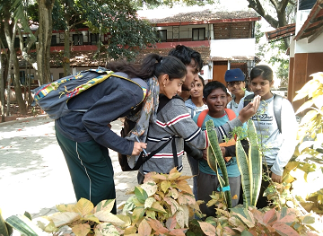

Slide 10
SPIDERS FOUND IN OUR SCHOOL
SL.NO | COMMAN NAME | SCIENTIFIC NAME | FAMILY | NUMBER
1 | ORB WEAVER | Eriophora sp. | Araneidae | 5
2 | GOLDEN ORB WEAVER | Nephila pilipes | Nephilinae | 16+
3 | RED ORB WEAVER | Neoscona domiciliorum | Araneidae | 3
4 | LYNX | Oxyopes salticus | Thorell | 10+
5 | JUMPING SPIDER | Menemerus bivittatus | Salticidae | Many
6 | ANT MIMICKING SAC SPIDER | Zodarion rubidum | Zodariidae | 6
7 | ANT MIMICKING CRAB SPIDER | Myrmarachne sp. | Thomisidae | 2

Slide 11
8 | HUNTSMAN SPIDER | Heteropoda venatoria | Sparassidae | 2
9 | GREEN HUNTMANS SPIDER | Olios milleti | Sparassidae | 4
10 | SIGNATURE SPIDER | Argiope pulchella | Argiope anasuja | 1
11 | DEBRIS SPIDER | Cyclosa turbinata | Araneidae | 5
12 | WANDERING SPIDER | Ctenus sp | Ctenidae | 4
13 | CRAB SPIDER | Thomisus sp | Thomisidae | 1
14 | LONG-JAWED ORB WEAVER | Tetragnatha versicolor | Tetragnathidae | 3
15 | ORNATE TREE TRUNK SPIDER | Herennia mutipuncta | Araneidae | 5

Slide 12
16 | TARANTULA |  | Therphosidae | 1
17 | WOLF SPIDER | Lycosa sp | Lycosidae | 2
18 | ORIANTAL SPINY ORB WEAVER | Gasteracantha germinata | Araneidae | 6
19 | TWO TAILED SPIDER | Hersilla savignyi | Hersiliidae | 5

Slide 13
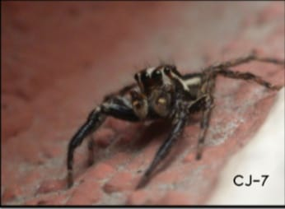
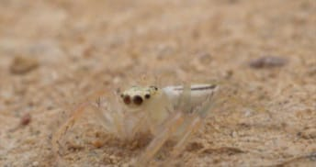
SPIDERS
MALE JUMPING
SPIDER
FEMALE JUMPING
SPIDER

Slide 14
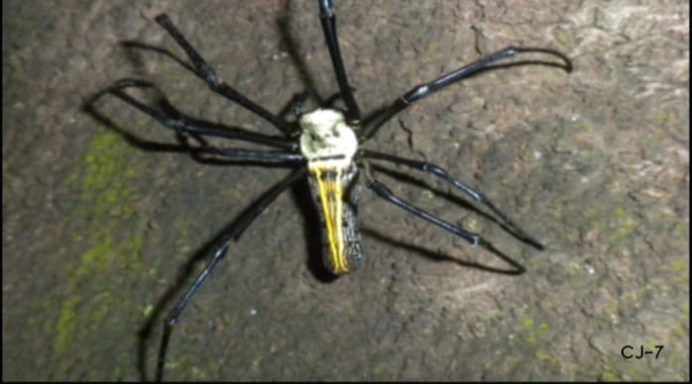
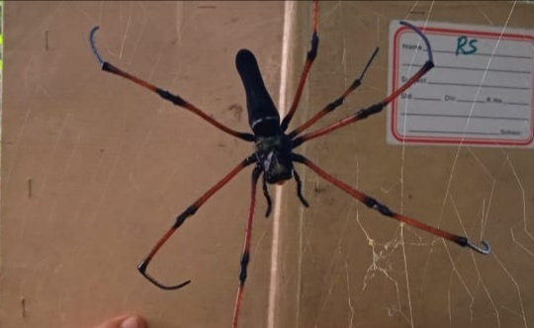
GOLDEN ORB
WEAVER
RED ORB
WEAVER

Slide 15
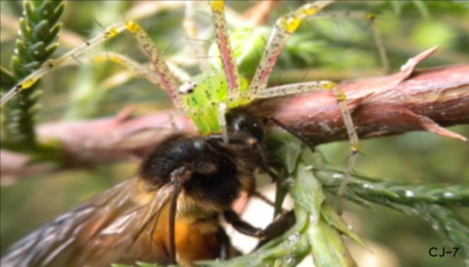
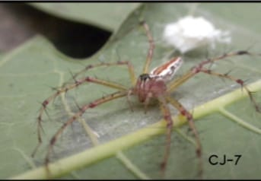
MALE LYNX
SPIDER
FEMALE LYNX
SPIDER

Slide 16
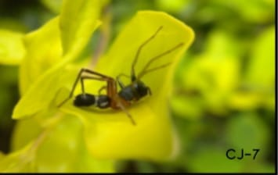
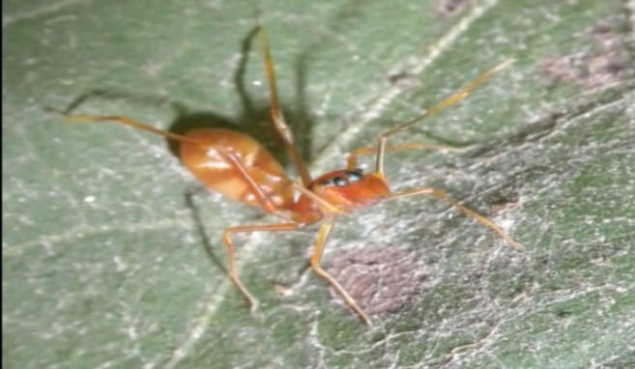
ANT MIMICKING SAC SPIDER
ANT MIMICKING
CRAB SPIDER

Slide 17
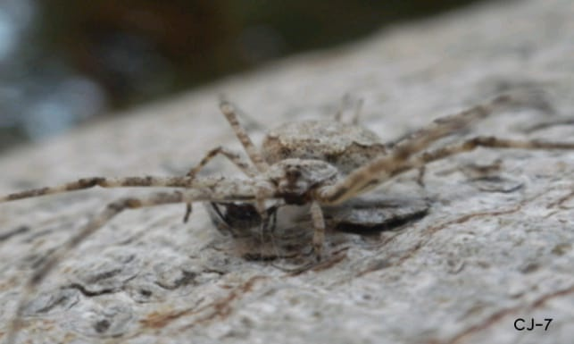
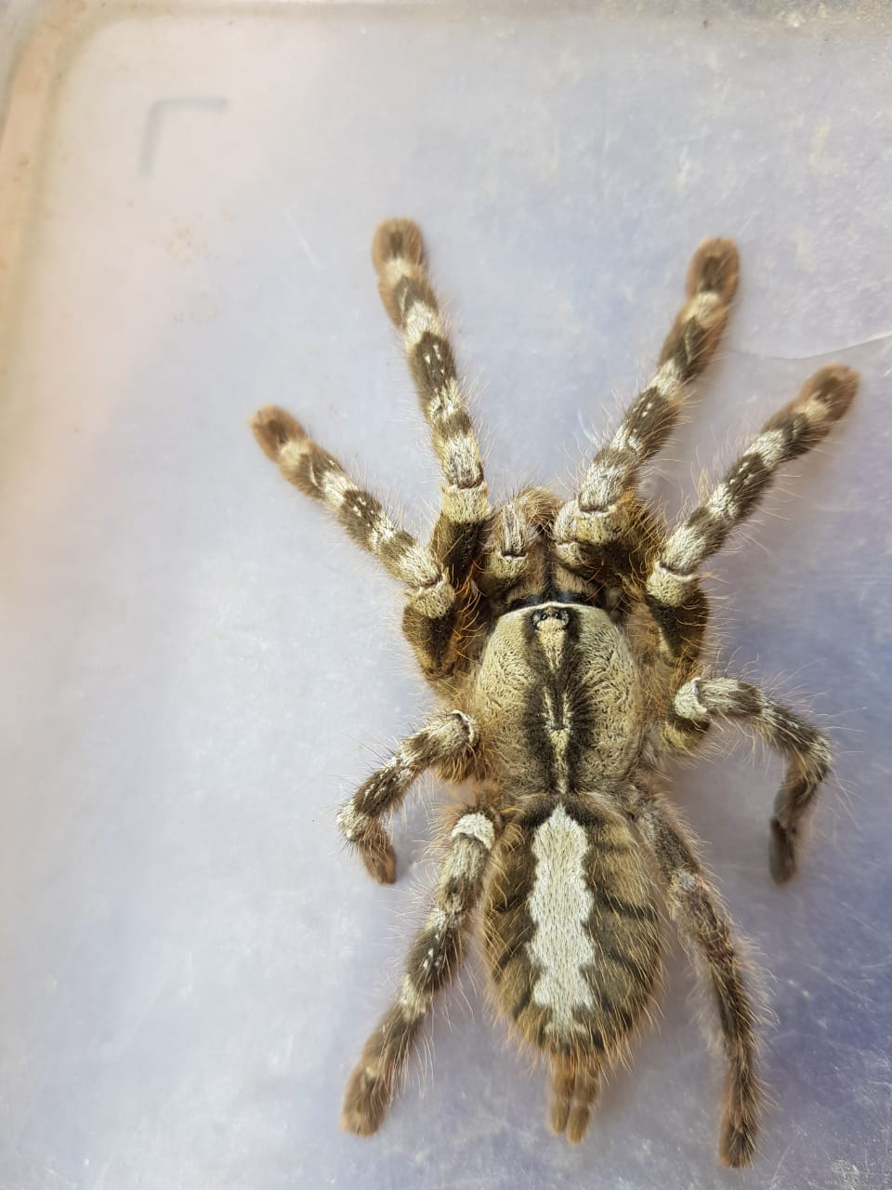
TWO TAILED
SPIDER
TARANTULA

Slide 18
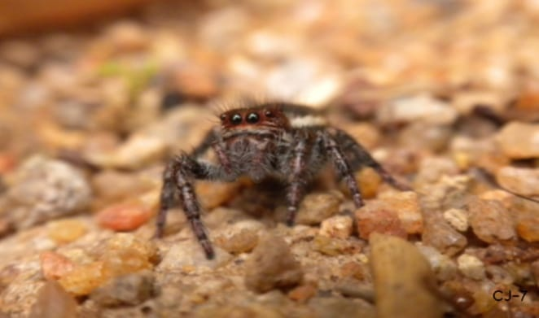
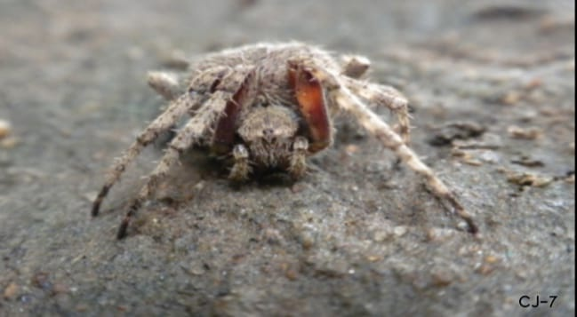
JUMPING
SPIDER
ORB WEAVER

Slide 19
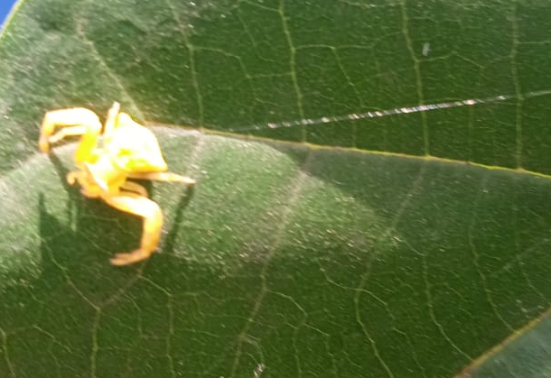
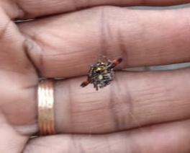
CRAB SPIDER
SPINY ORB WEAVER

Slide 20
WEB FACTS
“SPIDER SILK IS HIGHLY FLEXIBLE,EXTREMELY STRETCHABLE,SURPASSES STEEL IN STRENGTH AND MOST IMPORTANTLY CAN BE FORMED INTO A MESH THAT WOULD STOP A BULLET.”

Slide 21
SPIDER WEB
Spider web/cob web.
Proteinaceous spider silk extruded from its spinnerets.
Generally meant to catch its prey.
It has high tensile strength and extensibility.
The strength to weight ratio of the material is remarkable.
In UK – synthetic spider silk bandages.

Slide 22
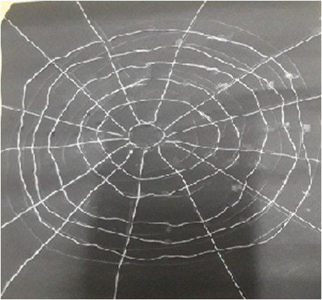
WEB

Slide 23
DRESS MADE OUT OF SPIDER WEB

Slide 24
MEASUREMENT OF SPIDER WEB

Slide 25
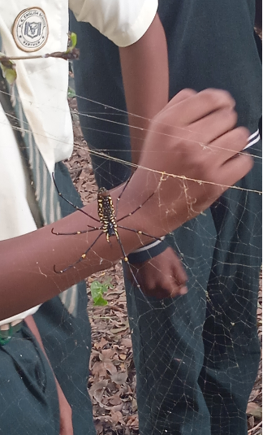
SPIDER IDENTIFICATION

Slide 26
METHOS OF IDENTIFING SPIDERS
By looking at their colours
By looking at the shape of their legs
By examining their eyes
By noticing the orientation of fangs
By estimating the size of the spider
By looking at their behaviour
By looking at their habitat

Slide 27
FACTS ABOUT SPIDERS
There are more than 30,000 different species of spider.
Female spiders are larger than male spiders.
Spiders have blue blood.
Spider’s silk is liquid produced by spinnerets.
Spiders have strange muscles.
Spiders love to dance, but not all spiders love to dance
WIDOW SPIDER

Slide 28
CONCLUSION
Urbanization – spiders vanished.
Our school-rich biodiversity, organic garden -19 species of spiders.
Biological control of pests.
THINK TWICE BEFORE YOU WIPE OUT A WEB

Slide 29
THANK YOU

